Slide 1

All Pairs Shortest Paths

Slide 2
Overview
All-pairs shortest path (APSP) algorithms try to find the shortest path from every node to every other node all at once.
One could run the Dijkstra or Bellman-Ford algorithms for each node, with running times O(VE lgV) or O(V²E), respectively.
Basis for Johnson’s Algorithm
But there are other ways that are faster.
Except for sparse graphs.

Slide 3
Johnson’s Algorithm for Sparse Graphs
Johnson’s algorithm is a faster way of solving the APSP problem if there are not very many edges in the graph.
That would mean |E| ≈ |V|
Maybe a little more
Common in real world situations

Slide 4
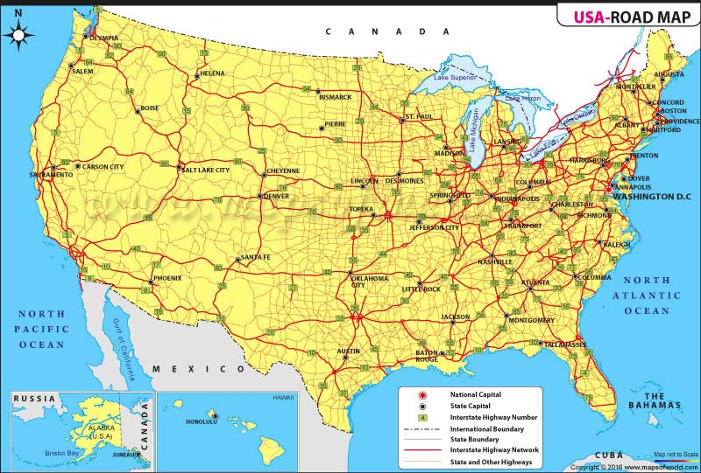
Sparse Graph example

Slide 5
Johnson’s Algorithm – general idea
One way to do the APSP problem would be to use a single-source shortest path algorithm from every node.
Generally, this would take longer than a dedicated APSP algorithm (i.e., Floyd-Warshall).
However, if the graph is sparse, O(E) = O(V), it can be quicker.
The key is that Dijkstra’s Algorithm (a.k.a., LCFS) can be a lot faster than the Bellman-Ford algorithm.
But to use it, all edges must have a non-negative weight.

Slide 6
Johnson’s Algorithm - Reweighting
Suppose the original weight function between nodes of the graph is w (which may have negative edges).
We want to replace it with a new weight function ŵ, having the properties:
For all pairs of nodes u,v ∈ V, the shortest path from u to v with weight function w is the shortest path from u to v with weight function ŵ.
For all edges (u,v) ∈ E, weight function ŵ(u,v) ≥ 0
Then we can run Dijkstra’s algorithm with weight function ŵ to find the shortest paths
And use original weight function w to find their lengths
If there isn’t a negative weight cycle.

Slide 7
Calculation of ŵ
Let h(v) be any function mapping vertices to real numbers. Then define weight function ŵ:
ŵ(u,v) = w(u,v) + h(u) – h(v).
The “trick” here will be to find a function h such that ŵ(u,v) will always be non-negative.

Slide 8
Property #1: Ŵ has same shortest path as W
Theorem: Define weight function ŵ:
ŵ(u,v) = w(u,v) + h(u) – h(v).
Then the shortest path from u to v using weight function w is the same as the shortest path from u to v using weight function ŵ.
Proof in textbook, it’s basically a lot of algebra.

Slide 9
Property #2: ŵ(u,v) nonnegative
We need to choose a function h(v) for each v∈V such that ŵ(u,v) is nonnegative for all (u,v).
To do this, create a new, larger graph that has a new source node s, with a zero-weight edge to every node in the existing graph.
Let h(v) be the distance from s to v (which could be negative [and if there is at least one negative-weight edge, it will be negative for at least one vertex]).
Use the Bellman-Ford Algorithm on the augmented graph
Define ŵ(u,v) = w(u,v) + h(u) – h(v).
It’s nonnegative, and meets Property #1.

Slide 10
The Johnson’s Algorithm
Compute G’ as V[G’] = V[G] ∪ {s} and E[G’] = E[G} ∪ {s,v}, ∀v∈V[G]
If (Bellman-Ford( G’, w, s ) == false // cycle
Report negative-weight cycle and exit
Else
For each vertex v∈V[G’]
h(v) = δ(s,v) as computed by Bellman-Ford on G’
For each edge (u,v) ∈E[G’]
ŵ(u,v) = w(u,v) + h(u) – h(v)
For each vertex u∈V[G]
Run Dijkstra(G, ŵ, u) to get đ(u,v) ∀v∈V[G] // wt under ŵ
For each vertex v∈V[G]
δ(u,v) = đ(u,v) + h(v) – h(u)
Running time with binary heap O(VE lg V)

Slide 11
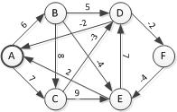
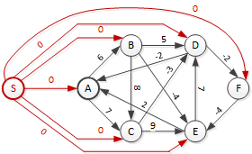
Johnson’s Algorithm in Pictures I

Slide 12
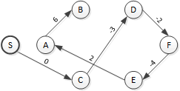
Johnson’s Algorithm in Pictures II
H(A) = -7
H(B) = -1
H(C) = 0
H(D) = -3
H(E) = -9
H(F) = -5

Slide 13
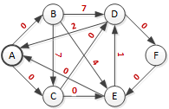
Johnson’s Algorithm in Pictures III
H(A) = -7
H(B) = -1
H(C) = 0
H(D) = -3
H(E) = -9
H(F) = -5

Slide 14
Finally
Finally, do Dijkstra’s Algorithm on this graph from each node and then reverse the calculations

Slide 15
Purpose-built APSP Algorithms
The purpose-built APSP algorithms are both dynamic programming algorithms.
A pair of good, relatively simple examples of Dynamic Programming.
The “Folklore” algorithm is intuitive
The Floyd-Warshall algorithm is faster, but less intuitive.

Slide 16
Structure of a shortest path
Let W = (w_{ij}) be adjacency matrix of graph G
So the entries contain the weights [lengths] of the edges
Let δ(i,j) be the shortest distance from i to j.
Call the path of this shortest distance path p.
Suppose the predecessor node to j in path p (from i ) is k.
I’m not saying how I found this out, but assume I know it.
Then δ(i,j) = δ(i,k) + w_{kj}
The shortest path contains within it shortest subpaths
Typical dynamic programming stuff

Slide 17
“Folklore” algorithm (1)
Let l_{ij}^{(m)} be the minimum weight of any path from i to j with at most m edges. Then

Slide 18
Folklore algorithm (2)
Then for longer paths, (n = nr. nodes in graph)
Note that k can explicitly = j
Then I_{ij}^{(m)} ₌ I_{ij}^{(m-1)}
If there are no negative weight cycles, then the shortest path is δ(i,j) = I_{ij}^{(n-1)}

Slide 19
“Folklore” algorithm (3)
Let L^{(k)} be the shortest path matrix of all I_{ij}^{(k).}
Then L⁽⁰⁾ is a diagonal matrix, and for k > 0:
L^{(k)} = L^{(k-1)} * W.
Thus we get the following algorithm:

Slide 20
“Folklore” Algorithm (4)
APSP1(W)
n = W.rows
L[1] = W
for (m = 2 to n-1)
L[m] = Extend (L[m-1],W)
return L[n-1]
Extend (L,W)
n = L.rows
for ( i = 1 to n )
for ( j = 1 to n )
l’_{ij} = ∞
for ( k = 1 to n )
l’_{ij} = min(l_{ij}, l_{ik} + w_{kj})
return L’

Slide 21
“Folklore” algorithm (5)
The three nested loops make Extend O(V³), and we do this V-1 times for an O(V⁴) algorithm.
But this can be made faster by repeated squaring.
Note that to compute x^{n} you need not multiply x by itself n-1 times. Rather you can start with x, and square it ⎣lg n⎦ times, then finish multiplying, if you store intermediate results.
Doing this reduces the algorithm’s cost to O(V³ lg V)
Actually, since l_{ij}^{(p)} = l_{ij}^{(n-1)} for all p > n-1, just square l_{ij}⁽⁰⁾ ⎡lg(n-1)⎤ times.

Slide 22
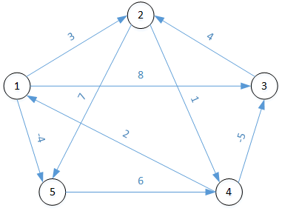
Example
L1 | 1 | 2 | 3 | 4 | 5
1
2
3
4
5
π1 | 1 | 2 | 3 | 4 | 5
1
2
3
4
5
L2 | 1 | 2 | 3 | 4 | 5
1
2
3
4
5
π2 | 1 | 2 | 3 | 4 | 5
1
2
3
4
5

Slide 23
Example
L1 | 1 | 2 | 3 | 4 | 5
1 | 0 | 3 | 8 | ∞ | -4
2 | ∞ | 0 | ∞ | 1 | 7
3 | ∞ | 4 | 0 | ∞ | ∞
4 | 2 | ∞ | -5 | 0 | ∞
5 | ∞ | ∞ | ∞ | 6 | 0
π1 | 1 | 2 | 3 | 4 | 5
1 | - | 1 | 1 | - | 1
2 | - | - | - | 2 | 2
3 | - | 3 | - | - | -
4 | 4 | - | 4 | - | -
5 | - | - | - | 5 | -
L2 | 1 | 2 | 3 | 4 | 5
1
2
3
4
5
π2 | 1 | 2 | 3 | 4 | 5
1
2
3
4
5

Slide 24
L1 | 1 | 2 | 3 | 4 | 5
1 | 0 | 3 | 8 | ∞ | -4
2 | ∞ | 0 | ∞ | 1 | 7
3 | ∞ | 4 | 0 | ∞ | ∞
4 | 2 | ∞ | -5 | 0 | ∞
5 | ∞ | ∞ | ∞ | 6 | 0
π1 | 1 | 2 | 3 | 4 | 5
1 | - | 1 | 1 | - | 1
2 | - | - | - | 2 | 2
3 | - | 3 | - | - | -
4 | 4 | - | 4 | - | -
5 | - | - | - | 5 | -
L2 | 1 | 2 | 3 | 4 | 5
1
2
3
4
5
π2 | 1 | 2 | 3 | 4 | 5
1
2
3
4
5

Slide 25
L1 | 1 | 2 | 3 | 4 | 5
1 | 0 | 3 | 8 | ∞ | -4
2 | ∞ | 0 | ∞ | 1 | 7
3 | ∞ | 4 | 0 | ∞ | ∞
4 | 2 | ∞ | -5 | 0 | ∞
5 | ∞ | ∞ | ∞ | 6 | 0
π1 | 1 | 2 | 3 | 4 | 5
1 | - | 1 | 1 | - | 1
2 | - | - | - | 2 | 2
3 | - | 3 | - | - | -
4 | 4 | - | 4 | - | -
5 | - | - | - | 5 | -
L2 | 1 | 2 | 3 | 4 | 5
1 | 0 | 3 | 8 | 2 | -4
2 | 3 | 0 | -4 | 1 | 7
3 | ∞ | 4 | 0 | 5 | 11
4 | 2 | -1 | -5 | 0 | -2
5 | 8 | ∞ | 1 | 6 | 0
π2 | 1 | 2 | 3 | 4 | 5
1 | - | 1 | 1 | 5 | 1
2 | 4 | - | 4 | 2 | 2
3 | - | 3 | - | 2 | 2
4 | 4 | 3 | 4 | - | 1
5 | 4 | - | 4 | 5 | -

Slide 26
“Folklore” algorithm (6)
Example: Suppose I want to calculate the shortest paths in a graph with 15 nodes. (Max path length 14)
l_{ij}⁽²⁾ = l_{ij}⁽¹⁾ * l_{ij}⁽¹⁾
l_{ij}⁽⁴⁾ = l_{ij}⁽²⁾ * l_{ij}⁽²⁾
l_{ij}⁽⁸⁾ = l_{ij}⁽⁴⁾ * l_{ij}⁽⁴⁾
l_{ij}⁽¹⁶⁾ = l_{ij}⁽⁸⁾ * l_{ij}⁽⁸⁾
But l_{ij}⁽¹⁴⁾ = l_{ij}⁽¹⁶⁾
4 multiplications rather than 14

Slide 27
Floyd-Warshall algorithm (1)
The Floyd-Warshall algorithm is another way of doing the dynamic programming for all-pairs-shortest-paths.
Although less intuitive than the “Folklore” algorithm, it is faster.
Give the vertices in some order (doesn’t matter what order, in theory), call it V₁, V₂, …, V_{n}

Slide 28
Floyd-Warshall algorithm (2)
The idea here is that we search for shortest paths:
first with no intermediate vertices
Same as “Folklore” algorithm
Then with intermediate vertex V₁
Then with intermediate vertices V₁ and/or V₂
Then with intermediate vertices V₁, V₂, and/or V₃
etc.

Slide 29
Floyd-Warshall algorithm (3)
So let d_{ij}^{(k)} be the shortest path between vertices i and j that only uses vertices in the set {V₁, …, V_{k}} as intermediate vertices.
Let D^{(k)} be the matrix of values d_{ij}^{(k)}.
Then

Slide 30
Floyd-Warshall algorithm (4)
Floyd-Warshall(W)
n = W.rows
D⁽⁰⁾ = W
for (k = 1 to n)
for ( i = 1 to n )
for ( j = 1 to n )
d_{ij}^{(k)} = min(d_{ij}^{(k-1)}, d_{ik}^{(k-1)} + d_{kj}^{(k-1)} )
return D^{(n)}
The initialization takes time O(V²).
The calculation d_{ij}^{(k)} = … is constant time, so the nested loops are O(V³), so the algorithm is O(V³).

Slide 31
Floyd-Warshall algorithm (5)
But we also want to find the shortest paths.
To do this, for each ordered pair of vertices, we define π_{ij} as the predecessor of j on the shortest path i→j.
Then for the shortest path i→j which has possible intermediate nodes V₁ through V_{k}, the predecessor of node V_{j} is either
The same as for the path from i → j whose intermediate vertices are drawn from V₁ through V_{k-1}
The predecessor node on the path from k → j whose intermediate vertices are drawn from V₁ through V_{k-1}
This might be node k.

Slide 32
Floyd-Warshall algorithm (6)

Slide 33
Example
D0 | 1 | 2 | 3 | 4 | 5
1
2
3
4
5
π0 | 1 | 2 | 3 | 4 | 5
1
2
3
4
5
D1 | 1 | 2 | 3 | 4 | 5
1
2
3
4
5
π1 | 1 | 2 | 3 | 4 | 5
1
2
3
4
5

Slide 34
D0 | 1 | 2 | 3 | 4 | 5
1 | 0 | 3 | 8 | ∞ | -4
2 | ∞ | 0 | ∞ | 1 | 7
3 | ∞ | 4 | 0 | ∞ | ∞
4 | 2 | ∞ | -5 | 0 | ∞
5 | ∞ | ∞ | ∞ | 6 | 0
π0 | 1 | 2 | 3 | 4 | 5
1 | - | 1 | 1 | - | 1
2 | - | - | - | 2 | 2
3 | - | 3 | - | - | -
4 | 4 | - | 4 | - | -
5 | - | - | - | 5 | -
D1 | 1 | 2 | 3 | 4 | 5
1
2
3
4
5
π1 | 1 | 2 | 3 | 4 | 5
1
2
3
4
5

Slide 35
Example
D0 | 1 | 2 | 3 | 4 | 5
1 | 0 | 3 | 8 | ∞ | -4
2 | ∞ | 0 | ∞ | 1 | 7
3 | ∞ | 4 | 0 | ∞ | ∞
4 | 2 | ∞ | -5 | 0 | ∞
5 | ∞ | ∞ | ∞ | 6 | 0
π0 | 1 | 2 | 3 | 4 | 5
1 | - | 1 | 1 | - | 1
2 | - | - | - | 2 | 2
3 | - | 3 | - | - | -
4 | 4 | - | 4 | - | -
5 | - | - | - | 5 | -
D1 | 1 | 2 | 3 | 4 | 5
1 | 0 | 3 | 8 | ∞ | -4
2 | ∞ | 0 | ∞ | 1 | 7
3 | ∞ | 4 | 0 | ∞ | ∞
4 | 2 | 5 | -5 | 0 | -2
5 | ∞ | ∞ | ∞ | 6 | 0
π1 | 1 | 2 | 3 | 4 | 5
1 | - | 1 | 1 | - | 1
2 | - | - | - | 2 | 2
3 | - | 3 | - | - | -
4 | 4 | 1 | 4 | - | 1
5 | - | - | - | 5 | -

